Slide 1






























4-BIT ADDER AND SUBTRACTOR & BCD ADDER
BY
HELLO-L TECH

Slide 2

HELLO EVERYONE
BATCH NO – B10
EXP-NO – 10
(*4-BIT BINARRY ADDER AND SUBTRATOR*)
&
(BCD ADDER)

Slide 3
INTRO

Slide 4
AIM
To verify the truth table of a BINARY ADDER AND SUBTRACTOR using
Multisim software.

Slide 5
COMPONENT REQUIRED
Multisim software
IC7483(4-bit adder)
IC7486(EX-OR GATE)
Digital input key
Basic Component(VCC,GND,SPDT,Indicators,etc)

Slide 6
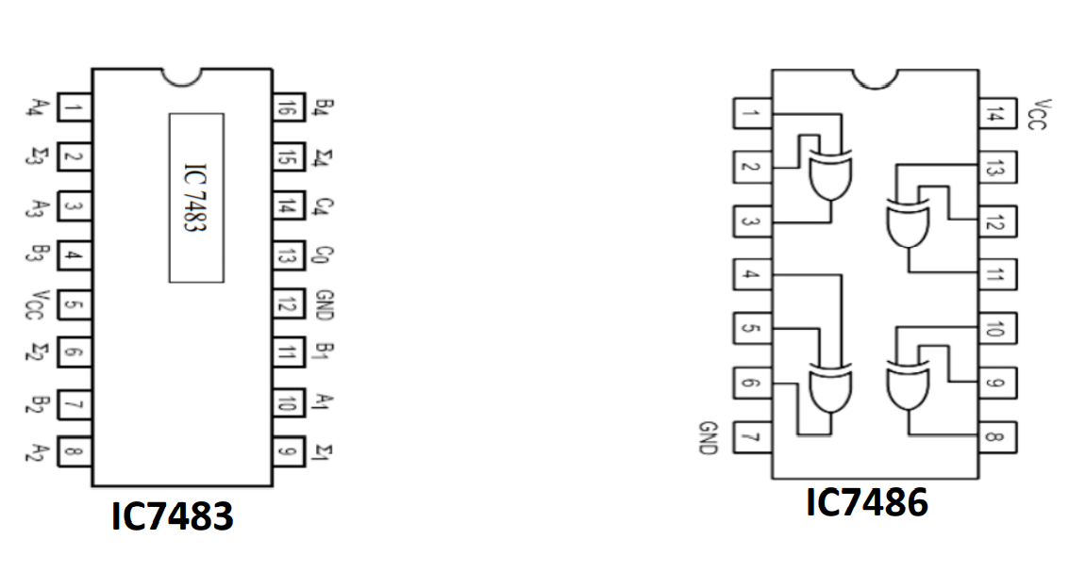
PIN DIAGRAM

Slide 7
CONCEPT

Slide 8
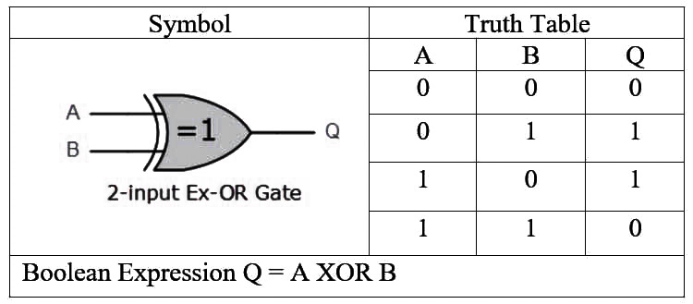
XOR gate operation
If one input is high it produce invert of the other input.
If one input is low it produce same of the other input.
Example
2’s complement
It represent a positive number as it is and negative number by its corresponding 2s-complement, so we can use the same circuit to perform addition and subtraction.
Example
(10 – 9) 1010 (binary of 10) (9 - 10) 1001 (binary of 9)
0111 (2’s complement of 9) 0110 (2’s complement of 10)
1 0001 1111 (Taking 2’s complement)
0001

Slide 9
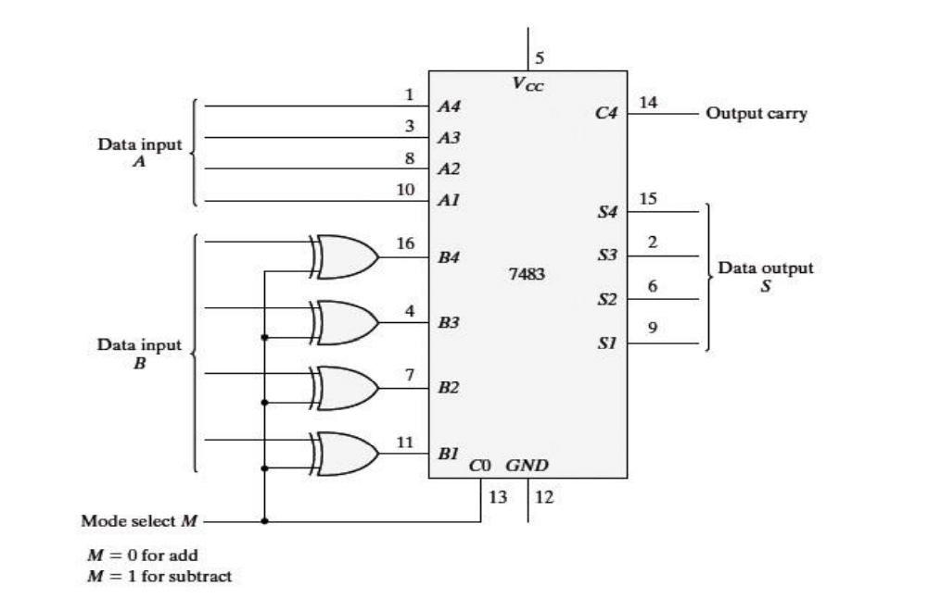
LOGIC DIAGRAM

Slide 10
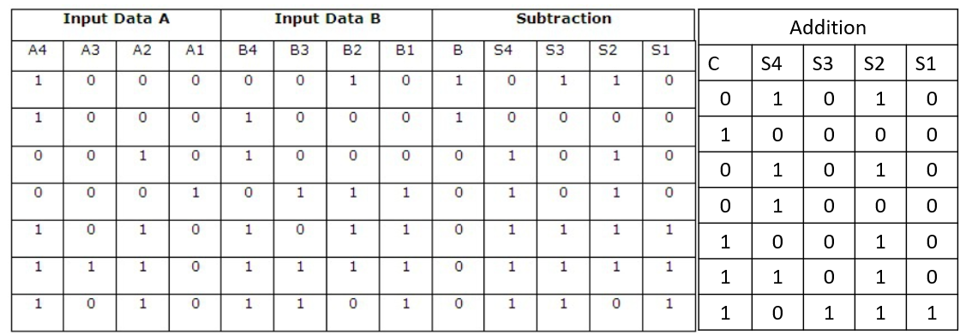
TRUTH TABLE

Slide 11
EXPERIMENT

Slide 12
PROCEDURE
Step1 - Open the Multisim software.
Step2 - Input components.
Step3 - IC’s and Basic components.
Step4 - Output components.
Step5 - connection.
Step6 - verify the result.

Slide 13
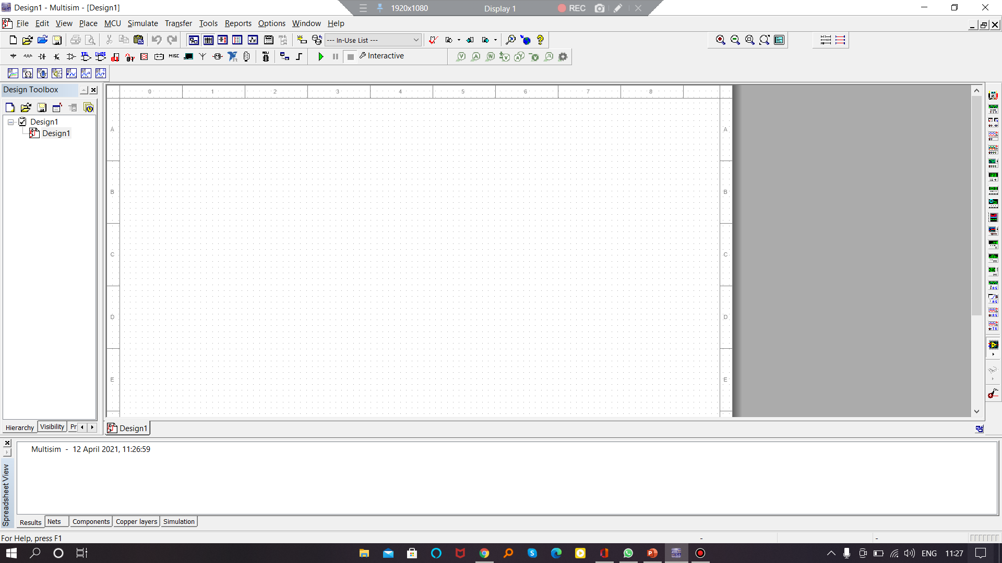
STEP1-(MULTISIM SOFTWARE)

Slide 14
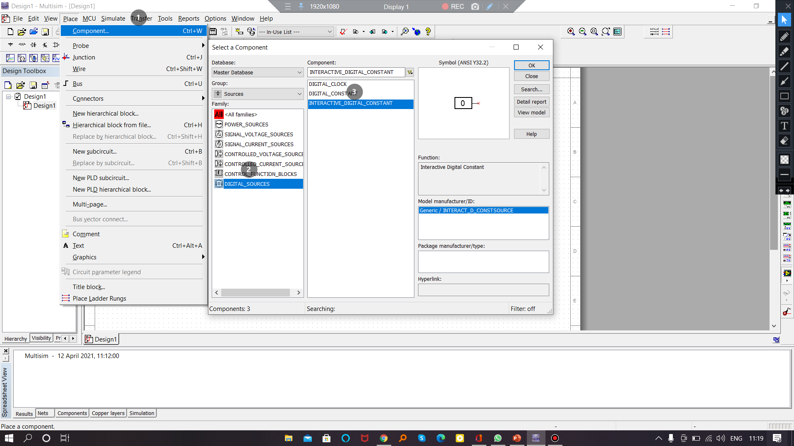
STEP2-(INPUT COMPONENTS)

Slide 15
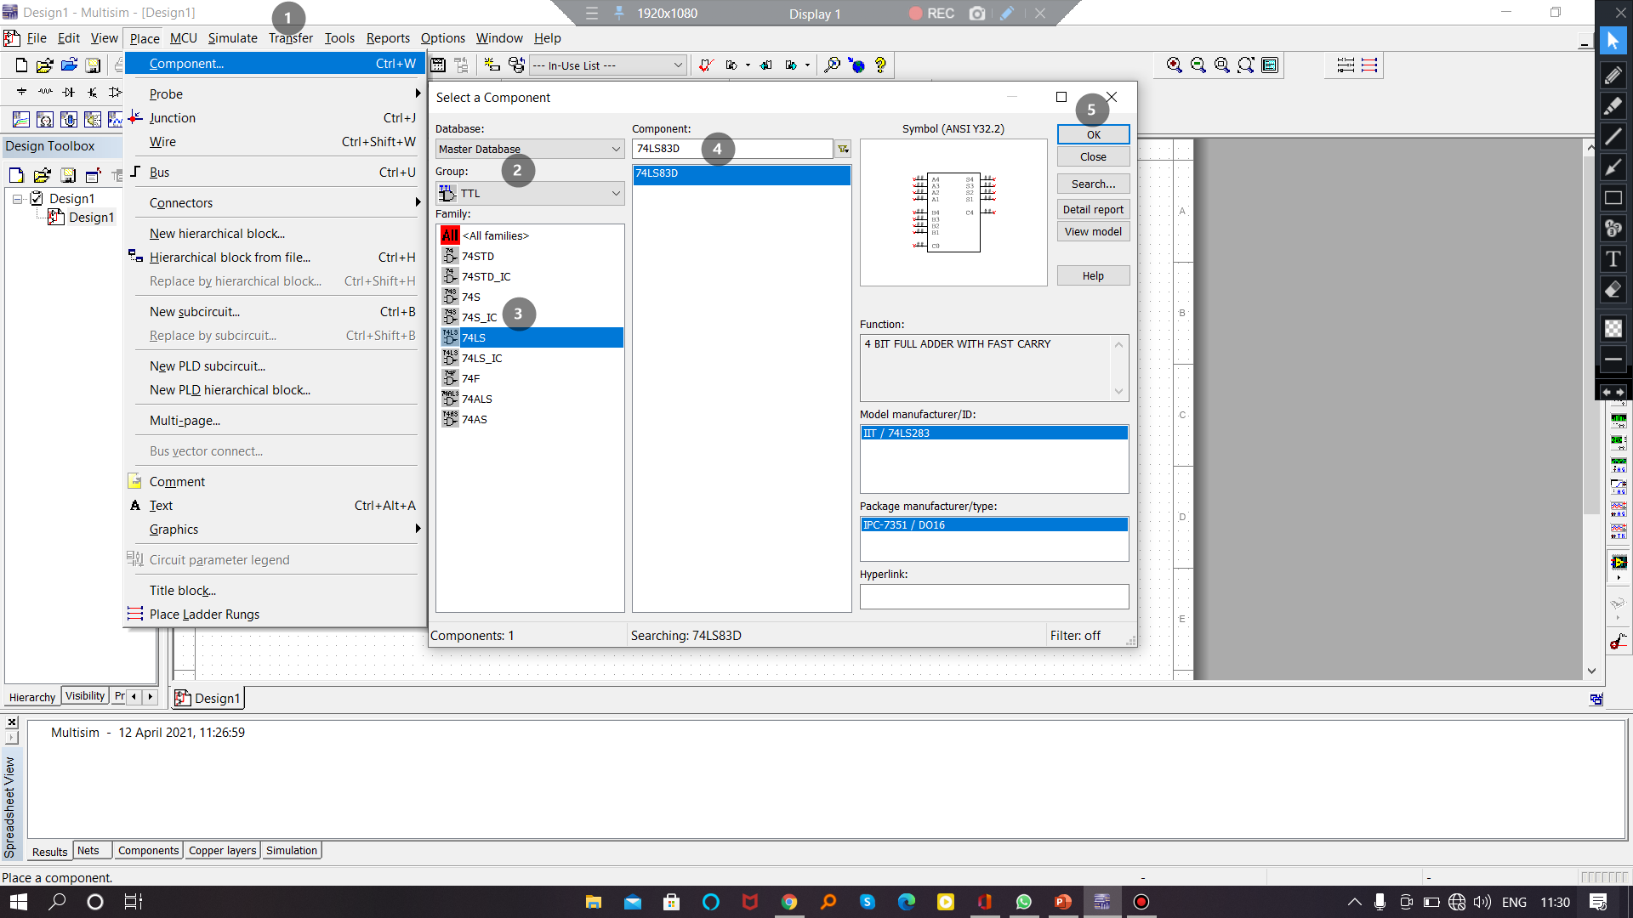
STEP3A-(IC SELECTION)

Slide 16
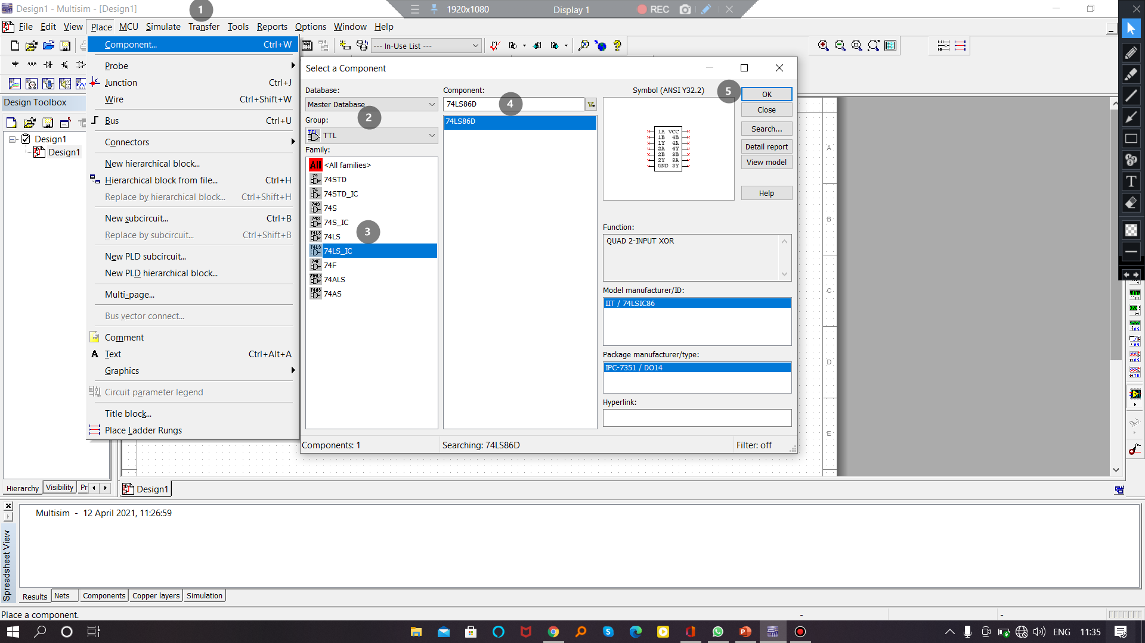
STEP3B-(IC SELECTION)

Slide 17
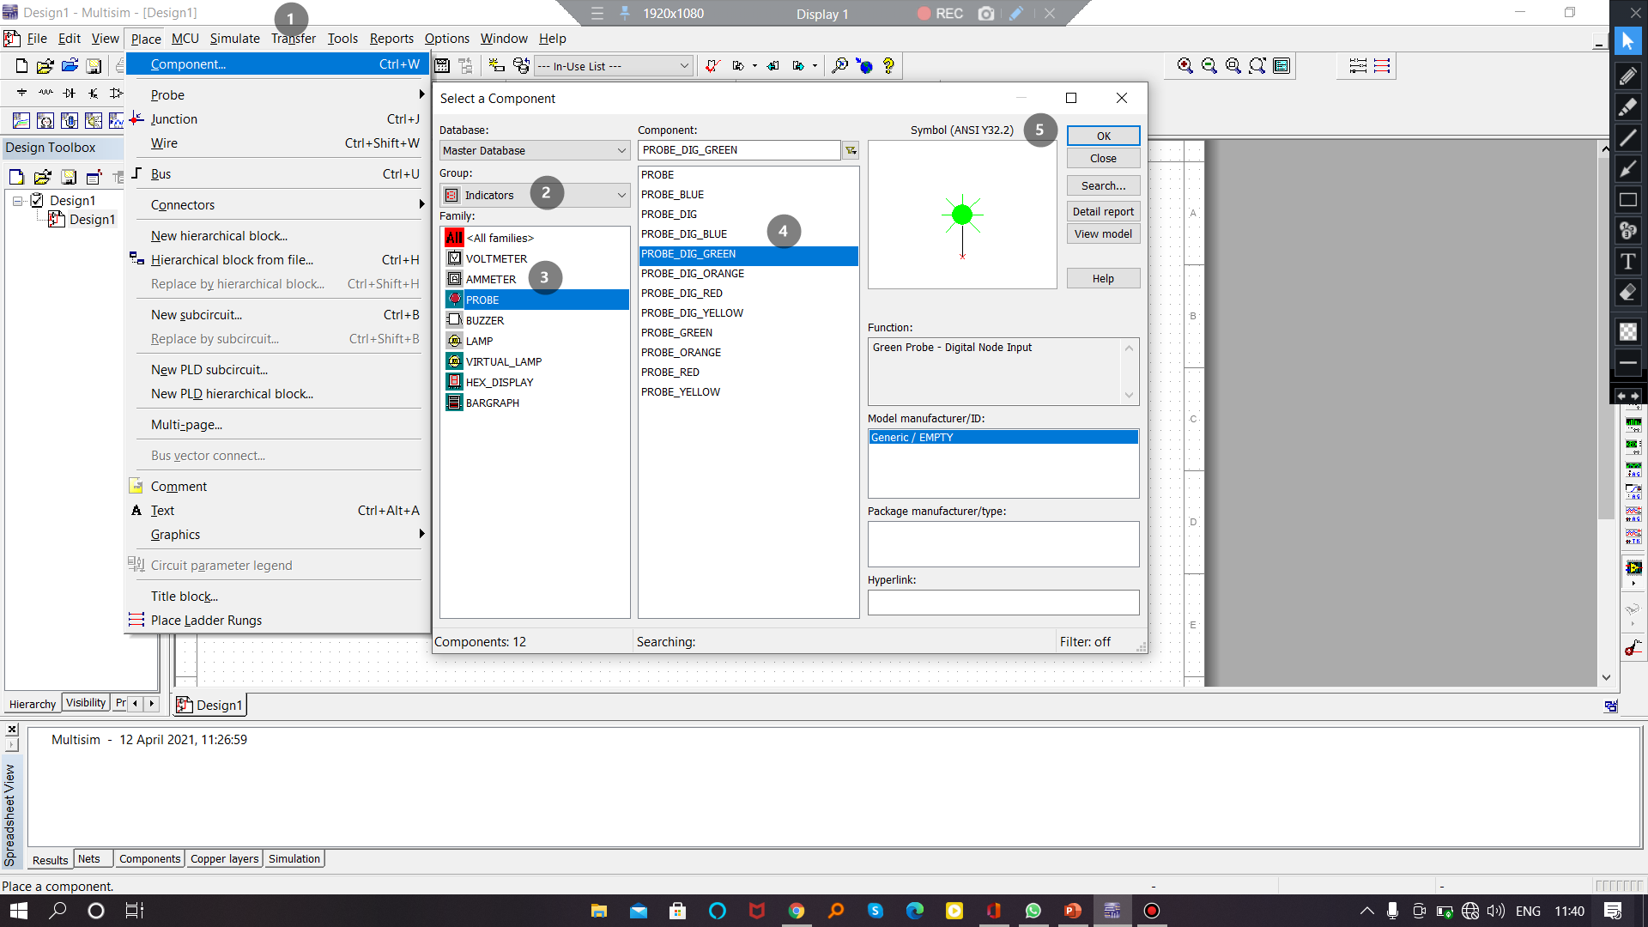
STEP4-(INDICATORS)

Slide 18
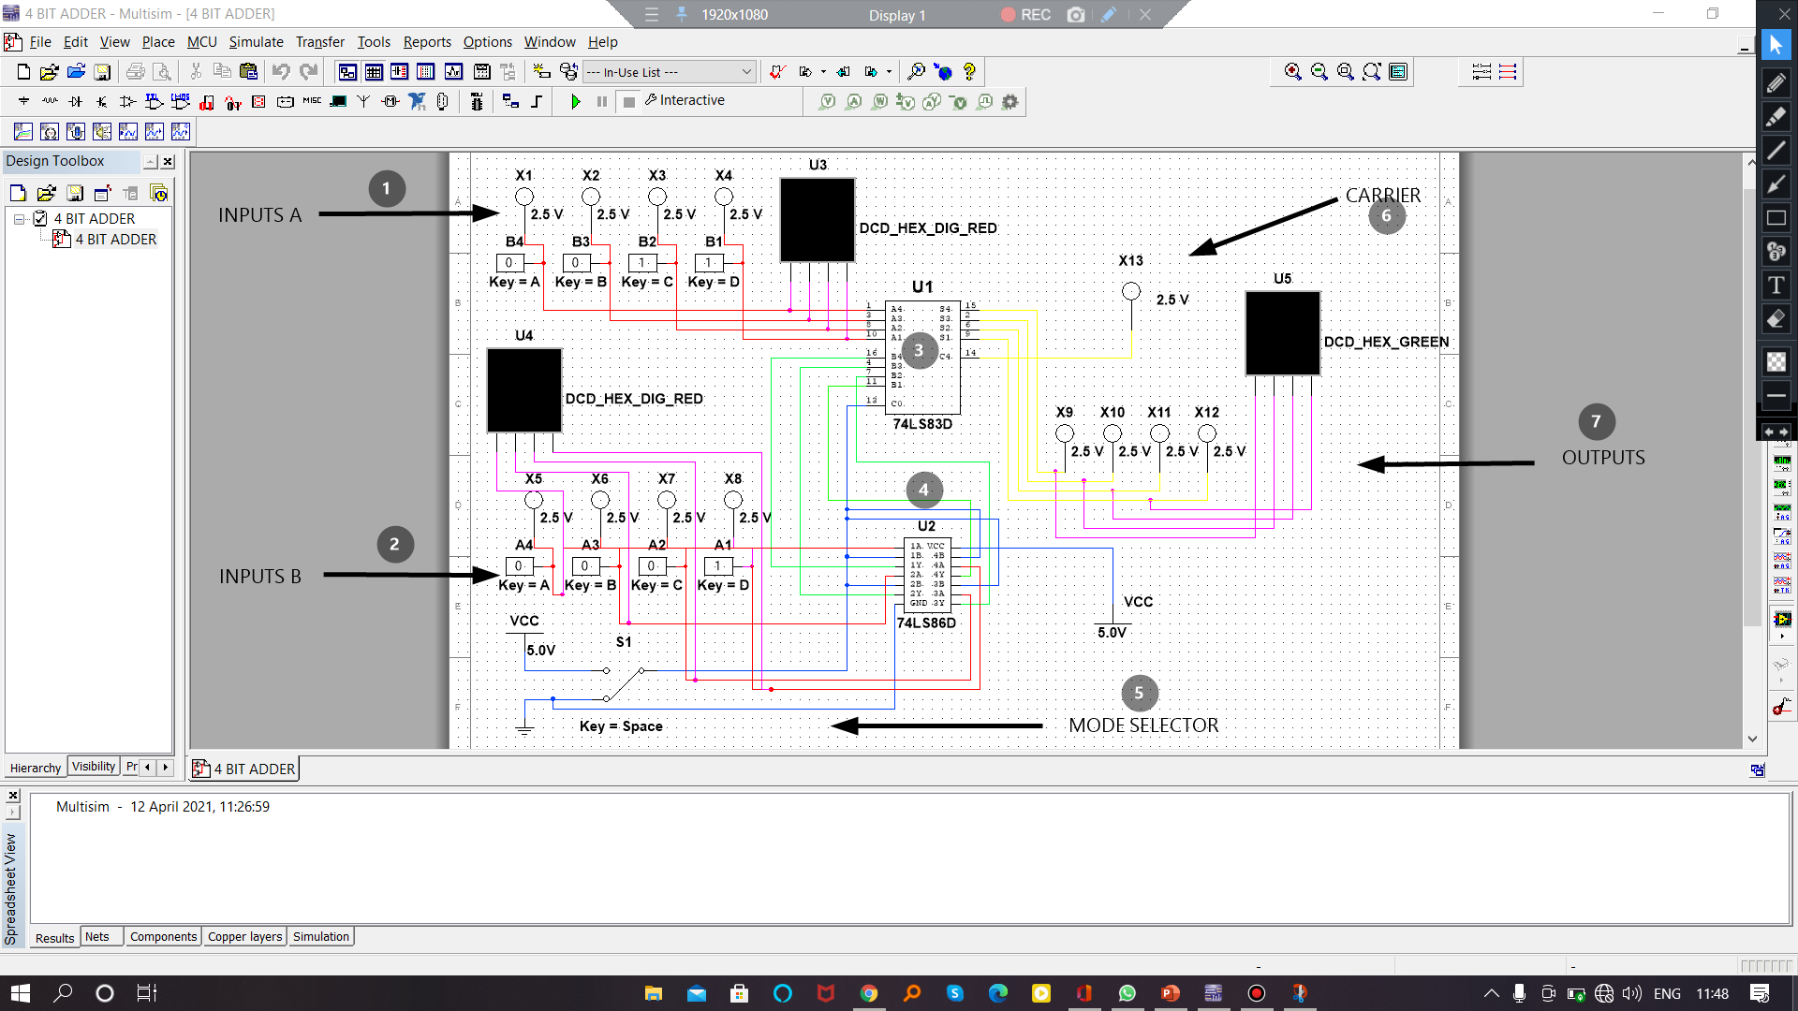
STEP5-(CONNECTIONS)

Slide 19
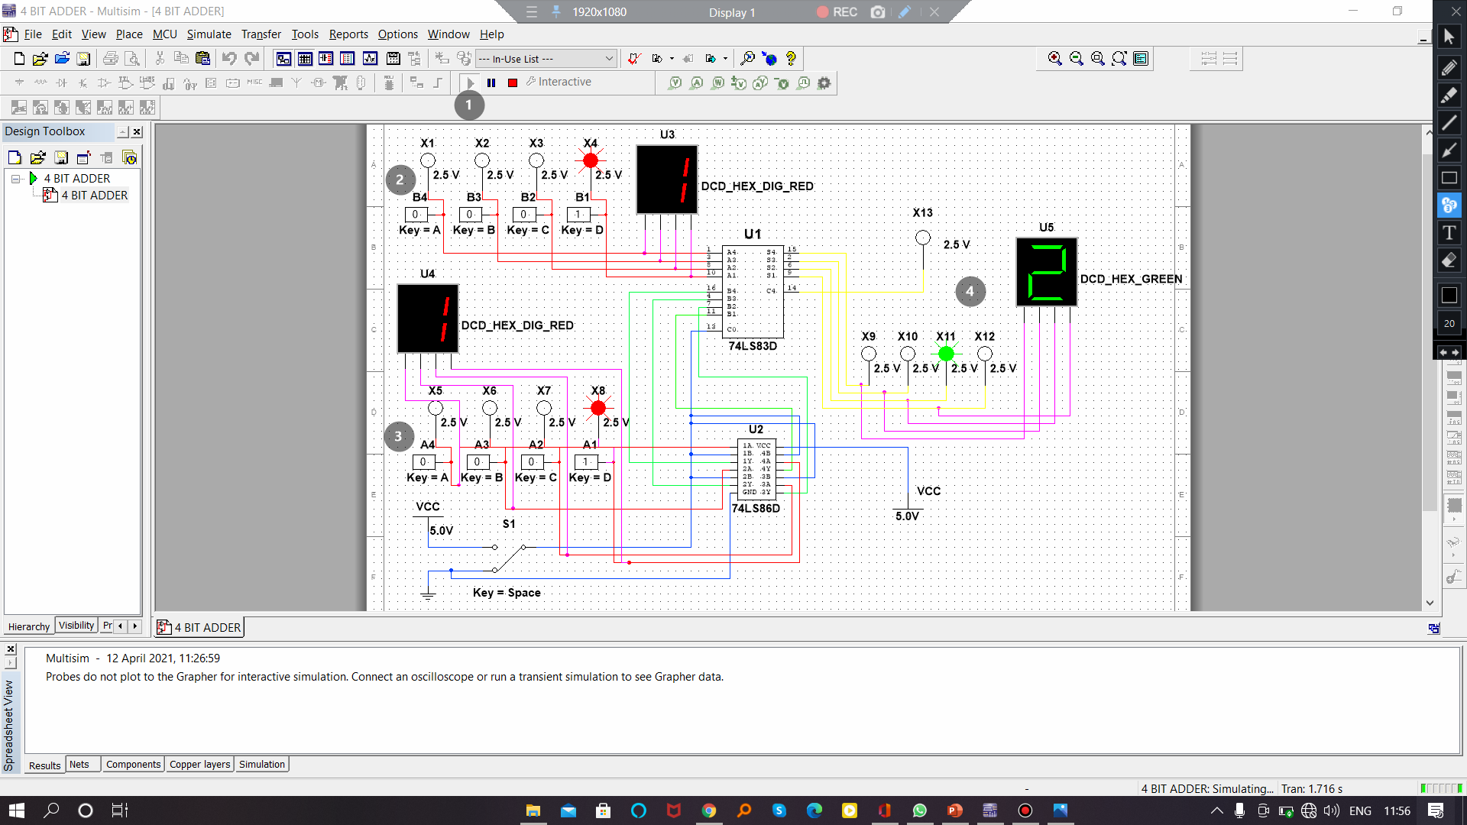
STEP6-(VERIFICATION)

Slide 20
MULTISIM

Slide 21
BCD ADDER
AIM
To verify the truth table of BCD Adder using Multisim software.
COMPONENTS
Multisim software
IC7483
IC7432(OR GATE)
IC7408(AND GATE)
Basic Components(Probe,Input keys,etc)

Slide 22
CONCEPT

Slide 23
BCD – BINARY CODED DECIMAL
0 1 2 3 4 5 6 7 8 9
The values greater than 9 are represented as two separate digits.
example
10 is represent as 1 0
The procedure to make two separate digits When the value exceed 9 is to add 6 (0110) to the value.
example
1 0 1 0 (binary 10)
0 1 1 0 (binary 06)
1 0 0 0 0

Slide 24
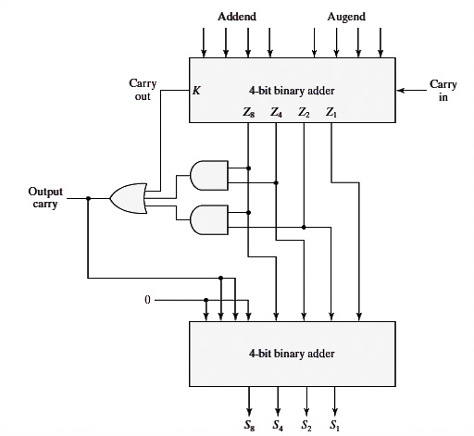
LOGIC DIAGRAM
(1)
(2)

Slide 25
LOGIC DIAGRAM
1 0 0 0
0 0 1 0
1 0 1 0
0+0+1
0
0
1
0 1 1 0

Slide 26
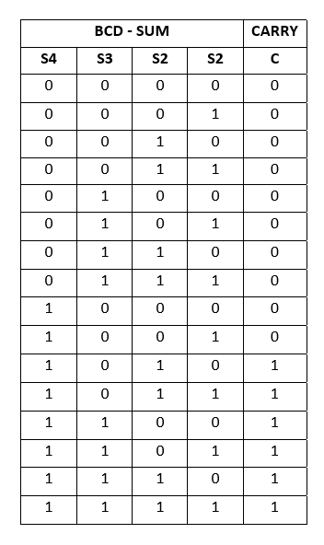
TRUTH TABLE

Slide 27
EXPERIMENT

Slide 28
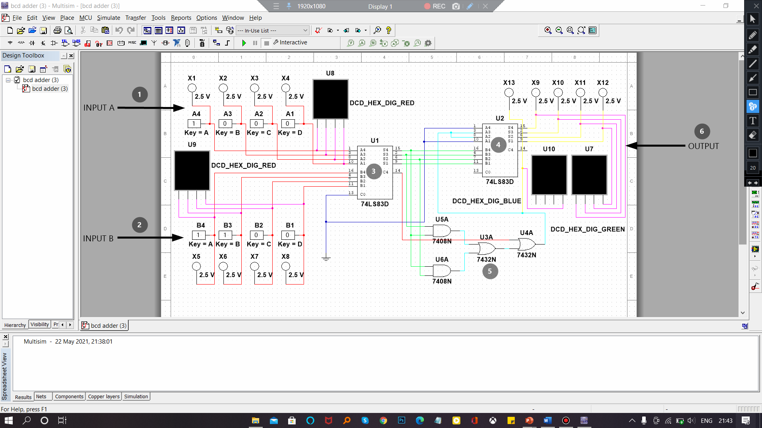
CONNECTION

Slide 29
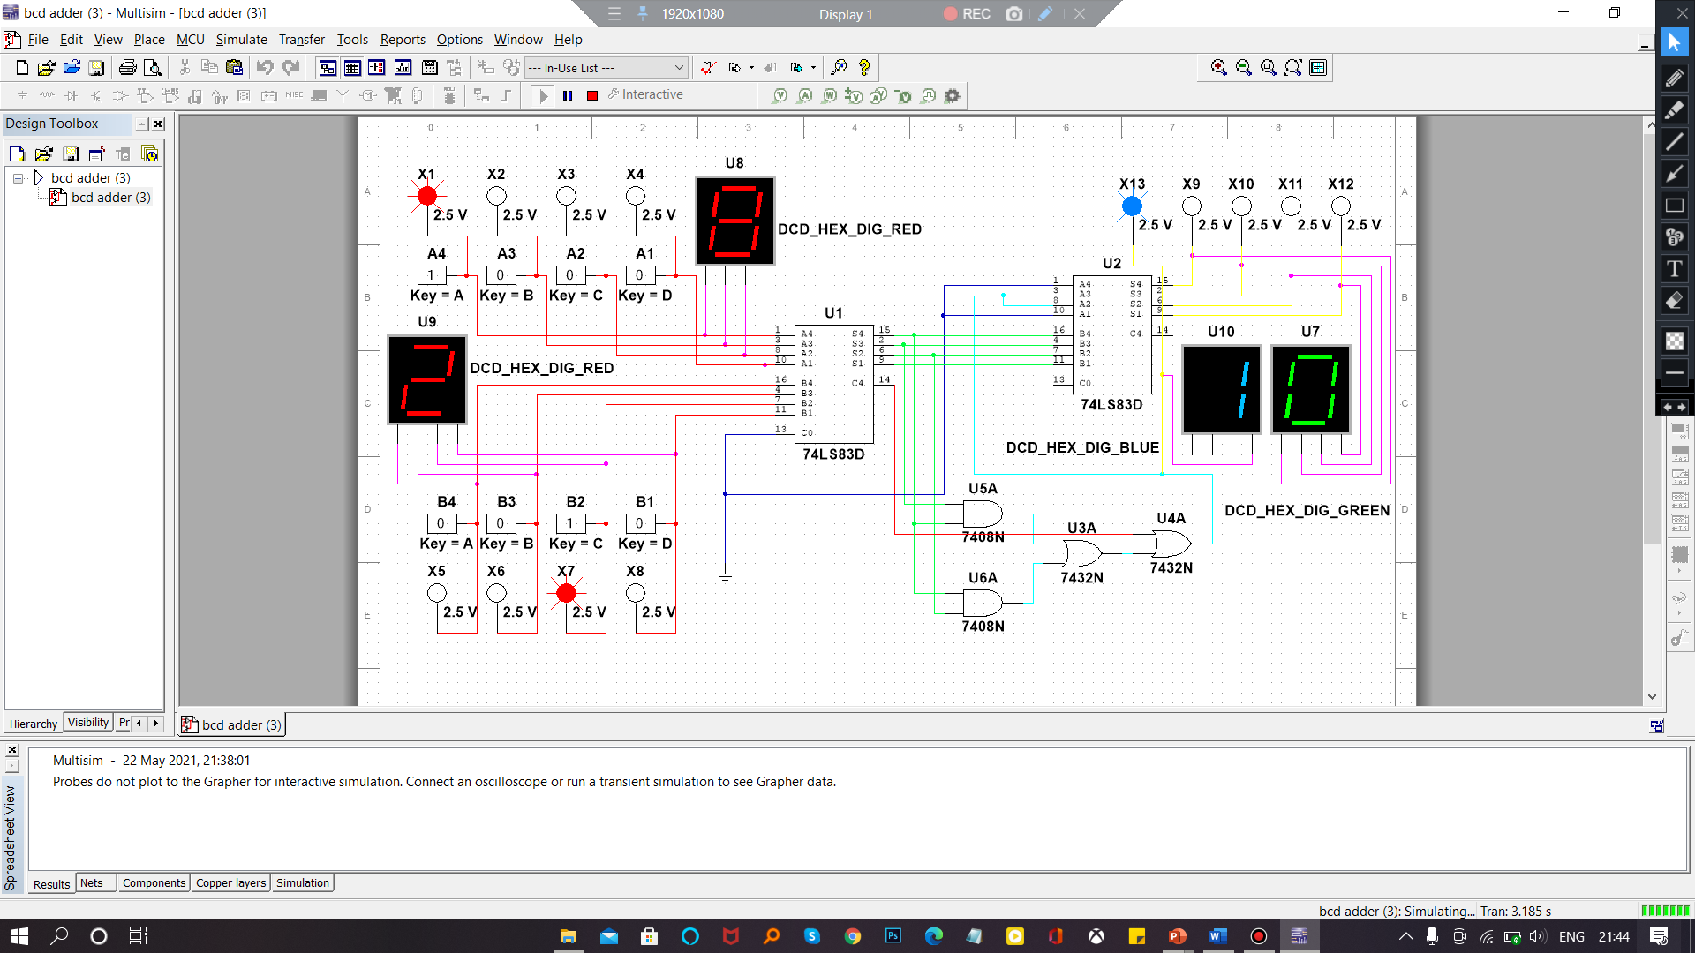
VERIFICATION

Slide 30
MULTISIM

Slide 31
TIPS
Check the selected component .
Check Vcc and Gnd connections.
Check the wire connection.
Use color difference in wire and probs.
Stop the program before you edit.
Make the circuit less complex.

Slide 32
THANK YOU

Slide 33


